Slide 1






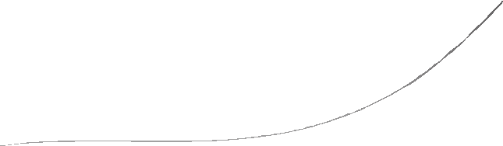














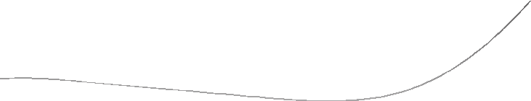
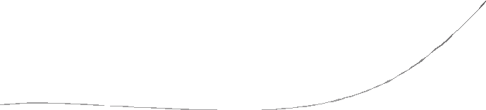
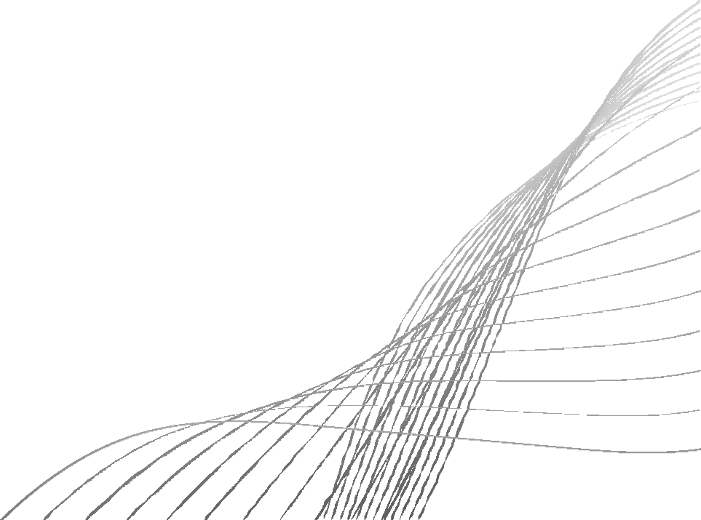
SIMPLE BLOG WITH COMMENTING
By- 23CDR049 GOWSALYA M 23CDR053 HARINI S

Slide 2

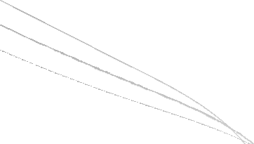

OVERVIEW
1. A blogging platform for creating, reading, and
commenting on blog posts.
2.
Includes user authentication, content creation, and nested comment functionality.
3.
Registered users can manage their blogs and interact through comments..

Slide 3

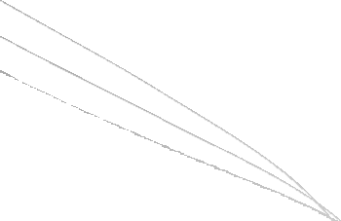

FEATURES -BLOG MANAGEMENT
1. Create and delete blog posts.
2.
View and Update blog posts
3.
Support for formatted content.

Slide 4
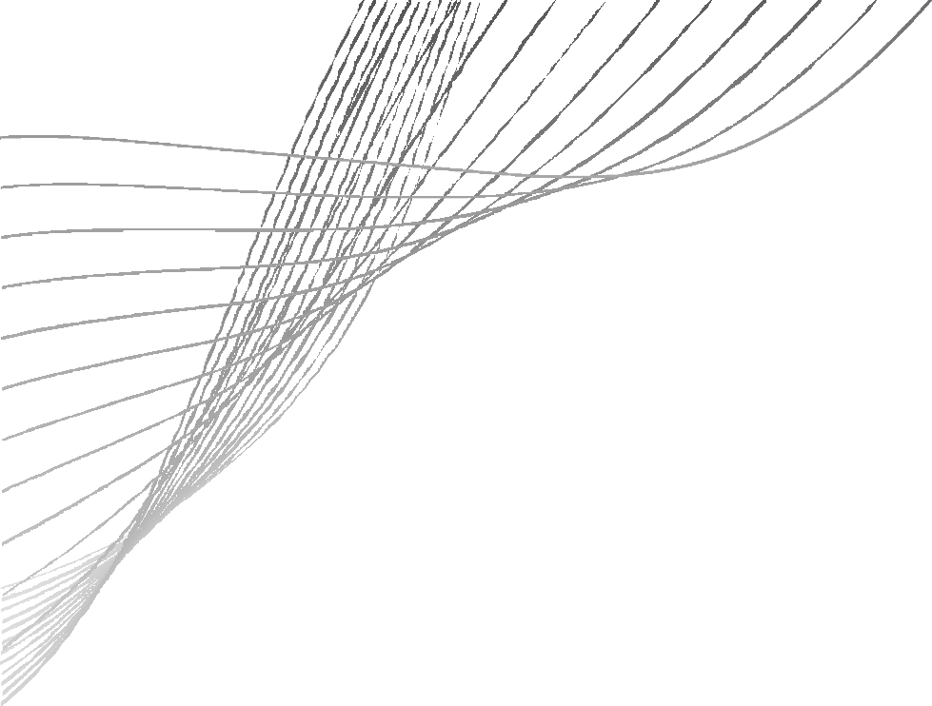

FEATURES - USER & AUTHENTICATION
1.
Register securely
2.
User profile management.
3.
Login and Logout securely

Slide 5
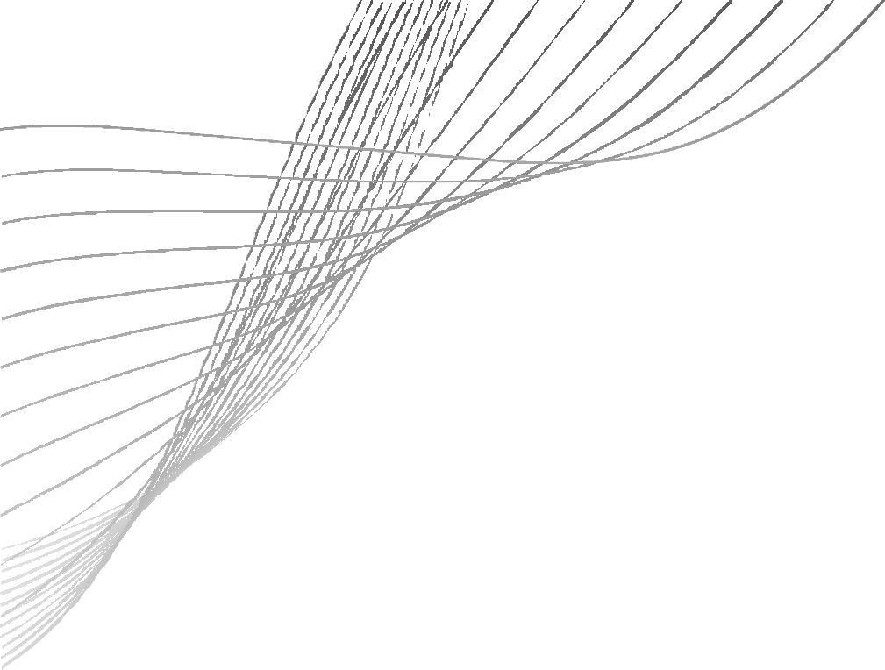
FEATURES - COMMENTING SYSTEM
1.
Comment on blog posts.
2.
Nested (threaded) comment support.
3.
Comment moderation by blog owner.

Slide 6
TECH STACK
* Frontend: HTML5, CSS3, JavaScript, Bootstrap
Backend: PHP and MySQL/ Node.js with Express
Database: MySQL
Dev Tools: GitHub, MySQL Workbench

Slide 7
TABLE STRUCTURE - USERS
1.
Users Table: Stores user account information.
2.
Primary Key: user_id
3. One-to-many: One user can create many blogs and comments

Slide 8
TABLE STRUCTURE - BLOGS
1.
Primary Key: post_id
2.
Foreign Key: user_id (references Users.id)
3.
One-to-many: One user can write multiple blogs.

Slide 9
TABLE STRUCTURE - COMMENTS
1.
Comments Table: Stores comments for blogs.
2.
Primary Key: comment_id
3.
Foreign Keys: blog_id, user_id, parent_comment_id
4.
Supports nested comments (self-referencing)

Slide 10



DATA MODEL
USER
BLOG_POST
COMMENTS

Slide 11
THANK YOU!!
By- 23CDR049 GOWSALYA M 23CDR053 HARINI S

